Slide 1
DESAIN ANALISIS ALGORITMA
ILUSTRASI

Slide 2
02
ASSIGNMENT PROBLEM
Bagian 1

Slide 3



MATRIKS ${ s}_{ix}t_{j}(m_{x}n)$
Task 1 | Task 2 | Task 3 | Task 4
 |  |  |  | Staff A
 |  |  |  | Staff B
 |  |  |  | Staff C
 |  |  |  | Staff D
$$m$$
$$n$$

Slide 4
MENGECEK KEMUNGKINAN
Task 1 | Task 2 | Task 3 | Task 4
10 | 7 | 5 | 6 | Staff A
8 | 9 | 3 | 2 | Staff B
1 | 6 | 15 | 8 | Staff C
12 | 7 | 3 | 4 | Staff D

Slide 5
PERCOBAAN KE-1
Task 1 | Task 2 | Task 3 | Task 4
10 | 7 | 5 | 6 | Staff A
8 | 9 | 3 | 2 | Staff B
1 | 6 | 15 | 8 | Staff C
12 | 7 | 3 | 4 | Staff D

Slide 6


PERCOBAAN KE-1
Task 1 | Task 2 | Task 3 | Task 4
10 | 7 | 5 | 6 | Staff A
8 | 9 | 3 | 2 | Staff B
1 | 6 | 15 | 8 | Staff C
12 | 7 | 3 | 4 | Staff D
$${ i}_{0}j_{0}$$
$$10$$

Slide 7


PERCOBAAN KE-1
Task 1 | Task 2 | Task 3 | Task 4
10 | 7 | 5 | 6 | Staff A
8 | 9 | 3 | 2 | Staff B
1 | 6 | 15 | 8 | Staff C
12 | 7 | 3 | 4 | Staff D
$${ i}_{0}j_{0}$$
+
$${ i}_{1}j_{1}$$
$$10$$
+
$$9$$

Slide 8


PERCOBAAN KE-1
Task 1 | Task 2 | Task 3 | Task 4
10 | 7 | 5 | 6 | Staff A
8 | 9 | 3 | 2 | Staff B
1 | 6 | 15 | 8 | Staff C
12 | 7 | 3 | 4 | Staff D
$${ i}_{0}j_{0}$$
+
$${ i}_{1}j_{1}$$
+
$${ i}_{2}j_{2}$$
$$10$$
+
$$9$$
+
$$15$$

Slide 9



PERCOBAAN KE-1
Task 1 | Task 2 | Task 3 | Task 4
10 | 7 | 5 | 6 | Staff A
8 | 9 | 3 | 2 | Staff B
1 | 6 | 15 | 8 | Staff C
12 | 7 | 3 | 4 | Staff D
$${ i}_{0}j_{0}$$
+
$${ i}_{1}j_{1}$$
+
$${ i}_{2}j_{2}$$
+
$${ i}_{3}j_{3}$$
$$10$$
+
$$9$$
+
$$15$$
+
$$4$$
= 38
Biaya

Slide 10
PERCOBAAN KE-1
Task 1 | Task 2 | Task 3 | Task 4
10 | 7 | 5 | 6 | Staff A
8 | 9 | 3 | 2 | Staff B
1 | 6 | 15 | 8 | Staff C
12 | 7 | 3 | 4 | Staff D
$${ i}_{0}j_{0}$$
+
$${ i}_{1}j_{1}$$
+
$${ i}_{2}j_{2}$$
+
$${ i}_{3}j_{3}$$
$$10$$
+
$$9$$
+
$$15$$
+
$$4$$
= 38
Biaya

Slide 11




PERCOBAAN KE-2
Task 1 | Task 2 | Task 3 | Task 4
10 | 7 | 5 | 6 | Staff A
8 | 9 | 3 | 2 | Staff B
1 | 6 | 15 | 8 | Staff C
12 | 7 | 3 | 4 | Staff D
$${ i}_{0}j_{0}$$
+
$${ i}_{1}j_{1}$$
+
$${ i}_{3}j_{2}$$
+
$${ i}_{2}j_{3}$$
$$10$$
+
$$9$$
+
$$8$$
+
$$3$$
= 30
Biaya

Slide 12
PERCOBAAN KE-2
Task 1 | Task 2 | Task 3 | Task 4
10 | 7 | 5 | 6 | Staff A
8 | 9 | 3 | 2 | Staff B
1 | 6 | 15 | 8 | Staff C
12 | 7 | 3 | 4 | Staff D
$${ i}_{0}j_{0}$$
+
$${ i}_{1}j_{1}$$
+
$${ i}_{3}j_{2}$$
+
$${ i}_{2}j_{3}$$
$$10$$
+
$$9$$
+
$$8$$
+
$$3$$
= 30
Biaya

Slide 13







PERCOBAAN KE-n
Task 1 | Task 2 | Task 3 | Task 4
10 | 7 | 5 | 6 | Staff A
8 | 9 | 3 | 2 | Staff B
1 | 6 | 15 | 8 | Staff C
12 | 7 | 3 | 4 | Staff D
$${ i}_{0}j_{1}$$
+
$${ i}_{1}j_{3}$$
+
$${ i}_{2}j_{0}$$
+
$${ i}_{3}j_{2}$$
$$7$$
+
$$2$$
+
$$1$$
+
$$3$$
= 13
Biaya
$13
Biaya Optimal

Slide 14

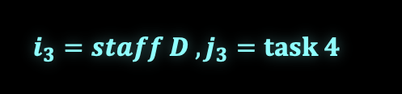


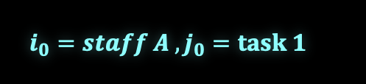



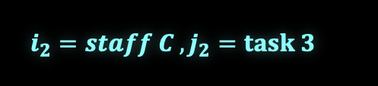

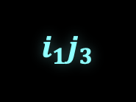

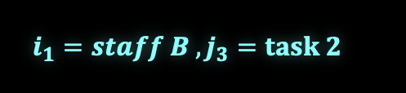
PERCOBAAN KE-n
Pembagian
Task 1 | Task 2 | Task 3 | Task 4
10 | 7 | 5 | 6 | Staff A
8 | 9 | 3 | 2 | Staff B
1 | 6 | 15 | 8 | Staff C
12 | 7 | 3 | 4 | Staff D
Task | Staff
Ingat $i=staff, j=task$
$$i_{0}=staff A , j_{0}=task 1$$
$$i_{1}=staff B , j_{3}=task 2$$
$$i_{2}=staff C , j_{2}=task 3$$
$$i_{3}=staff D , j_{3}=task 4$$
$13
Biaya Optimal
$${ i}_{0}j_{1}$$
+
$${ i}_{1}j_{3}$$
+
$${ i}_{2}j_{0}$$
+
$${ i}_{3}j_{2}$$
+
$$1$$
= 13
$$7$$
+
$$2$$
+
$$3$$
Biaya

Slide 15
PERCOBAAN KE-n
Pembagian
Task 1 | Task 2 | Task 3 | Task 4
10 | 7 | 5 | 6 | Staff A
8 | 9 | 3 | 2 | Staff B
1 | 6 | 15 | 8 | Staff C
12 | 7 | 3 | 4 | Staff D
Task | Staff
2 | A
4 | B
1 | C
3 | D
Ingat $i=staff, j=task$
$$i_{0}=staff A , j_{0}=task 1$$
$$i_{1}=staff B , j_{3}=task 2$$
$$i_{2}=staff C , j_{2}=task 3$$
$$i_{3}=staff D , j_{3}=task 4$$
$13
Biaya Optimal
$${ i}_{0}j_{1}$$
+
$${ i}_{1}j_{3}$$
+
$${ i}_{2}j_{0}$$
+
$${ i}_{3}j_{2}$$
+
$$1$$
= 13
$$7$$
+
$$2$$
+
$$3$$
Biaya

Slide 16
02
TOWER OF HANOI
Bagian 2
ILUSTRASI

Slide 17
A
B
C
SEMUA Cakram DI A MOVE C

Slide 18
A
B
C
SEMUA Cakram DI C

Slide 19
A
B
C

Slide 20
Cakram 1 MOVE Dari A → B
A
B
C

Slide 21
A
B
C
Cakram 2 MOVE Dari A → 2

Slide 22
A
B
C
Cakram 1 MOVE Dari B → C

Slide 23
A
B
C
Cakram 3 MOVE Dari A → B

Slide 24
A
B
C
Cakram 1 MOVE Dari C → A

Slide 25
A
B
C
Cakram 2 MOVE Dari C → B

Slide 26
A
B
C
Cakram 1 MOVE Dari A → B

Slide 27
A
B
C
Cakram 2 MOVE Dari A → C

Slide 28
A
B
C
Cakram 1 MOVE Dari B → C

Slide 29
A
B
C
Cakram 2 MOVE Dari B → A

Slide 30
A
B
C
Cakram 1 MOVE Dari C → A

Slide 31
A
B
C
Cakram 3 MOVE Dari B → C

Slide 32
A
B
C
Cakram 1 MOVE Dari A → B

Slide 33
A
B
C
Cakram 2 MOVE Dari A → C

Slide 34
A
B
C
Cakram 1 MOVE Dari B → A

Slide 35
A
B
C
SEMUA Cakram DI C

